Slide 1
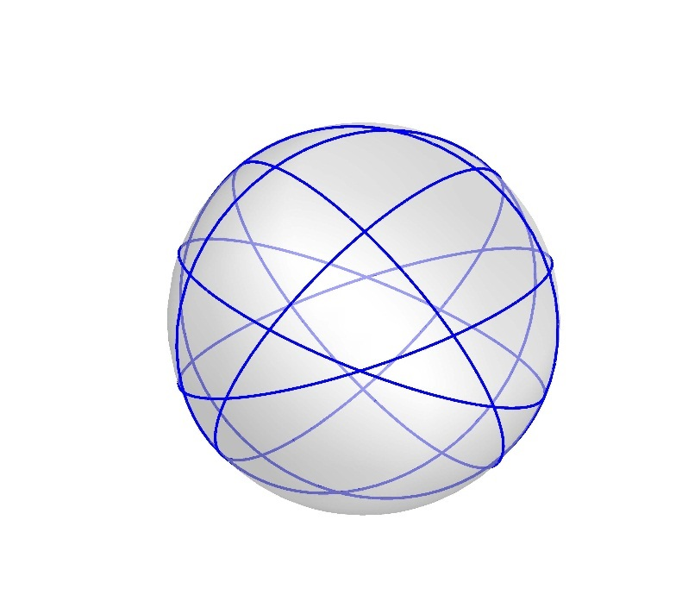
Great Circles Problem
Kha Man
04/21/2015

Slide 2
Outline
Lemma 1
Lemma 2 – The uniqueness of the special graph S_{k}
Lemma 3 – The equivalent graph of S_{k}
Lemma 4 – The properties of S_{k}
Theorem 1 – The chromatic number of S_{k}
The next steps

Slide 3
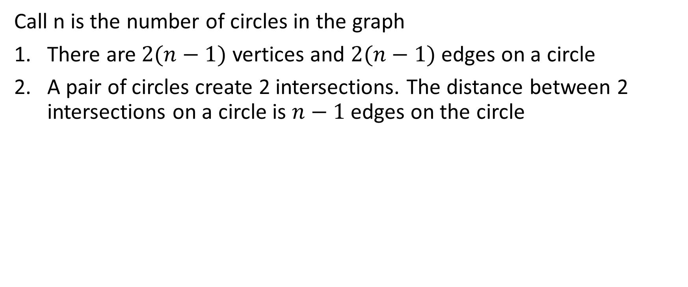
Lemma 1
Call n is the number of circles in the graph
There are $2(n−1)$ vertices and $2(n−1)$ edges on a circle
A pair of circles create 2 intersections. The distance between 2 intersections on a circle is $n−1$ edges on the circle

Slide 4
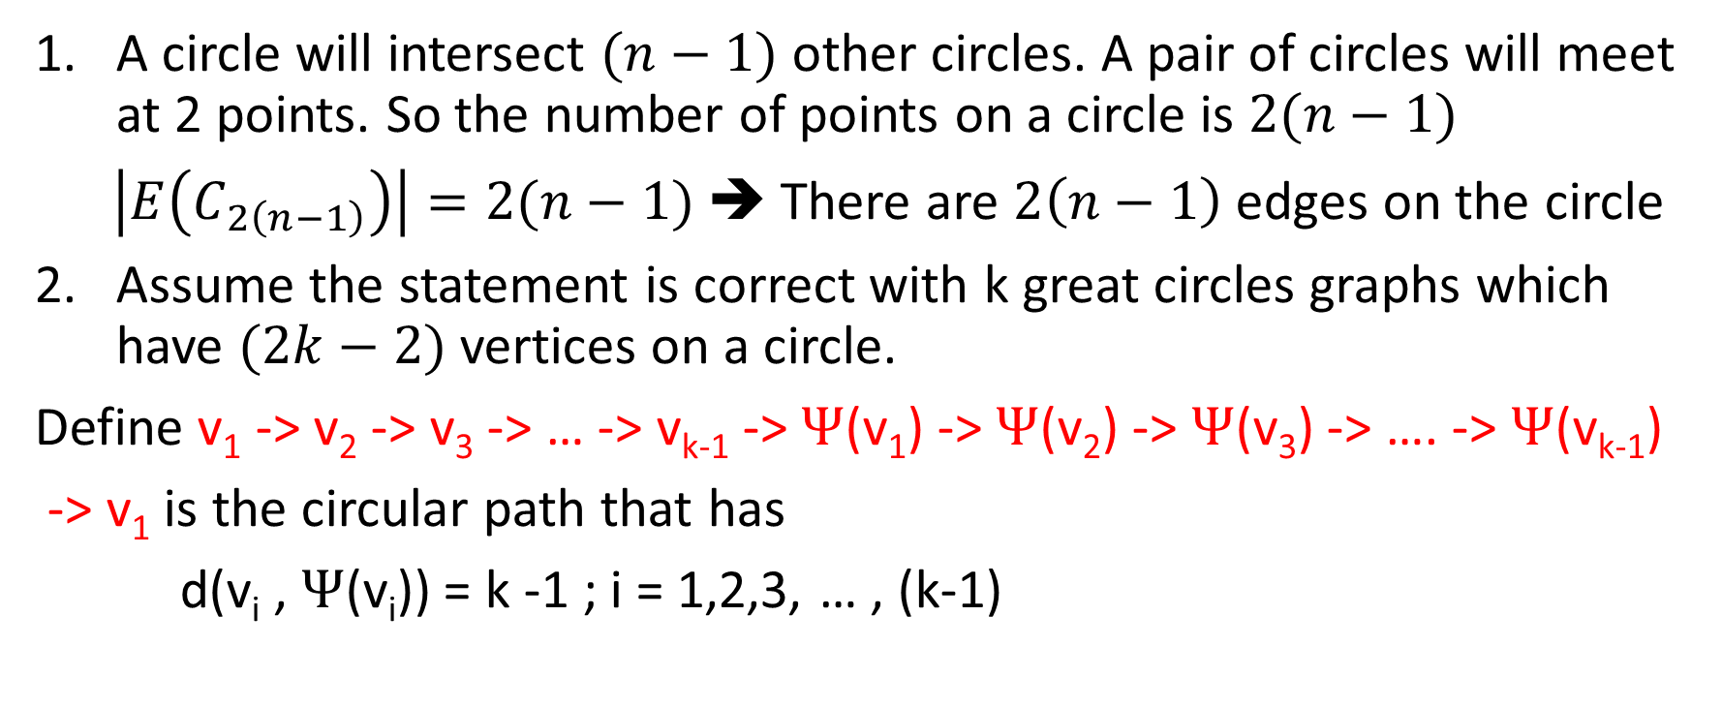
Lemma 1 - Proof
A circle will intersect $(n−1)$ other circles. A pair of circles will meet at 2 points. So the number of points on a circle is $2(n−1)$
$\left|E\left(C_{2\left(n−1\right)}\right)\right|=2(n−1)$ ➔ There are $2\left(n−1\right)$ edges on the circle
Assume the statement is correct with k great circles graphs which have $(2k−2)$ vertices on a circle.
Define v₁ -> v₂ -> v₃ -> … -> v_{k-1} -> $Ψ$(v₁) -> $Ψ$(v₂) -> $Ψ$(v₃) -> …. -> $Ψ$(v_{k-1})
-> v₁ is the circular path that has
d(v_{i} , $Ψ$(v_{i})) = k -1 ; i = 1,2,3, … , (k-1)

Slide 5
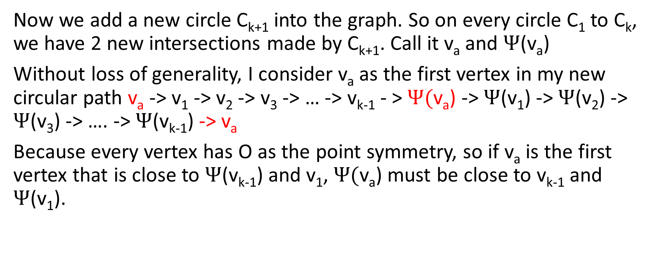
Lemma 1 - Proof
Now we add a new circle C_{k+1} into the graph. So on every circle C₁ to C_{k}, we have 2 new intersections made by C_{k+1}. Call it v_{a} and $Ψ$(v_{a})
Without loss of generality, I consider v_{a} as the first vertex in my new circular path v_{a} -> v₁ -> v₂ -> v₃ -> … -> v_{k-1} - > $Ψ($v_{a}) -> $Ψ$(v₁) -> $Ψ$(v₂) -> $Ψ$(v₃) -> …. -> $Ψ$(v_{k-1}) -> v_{a}
Because every vertex has O as the point symmetry, so if v_{a} is the first vertex that is close to $Ψ$(v_{k-1}) and v₁, $Ψ($v_{a}) must be close to v_{k-1} and $Ψ$(v₁).

Slide 6
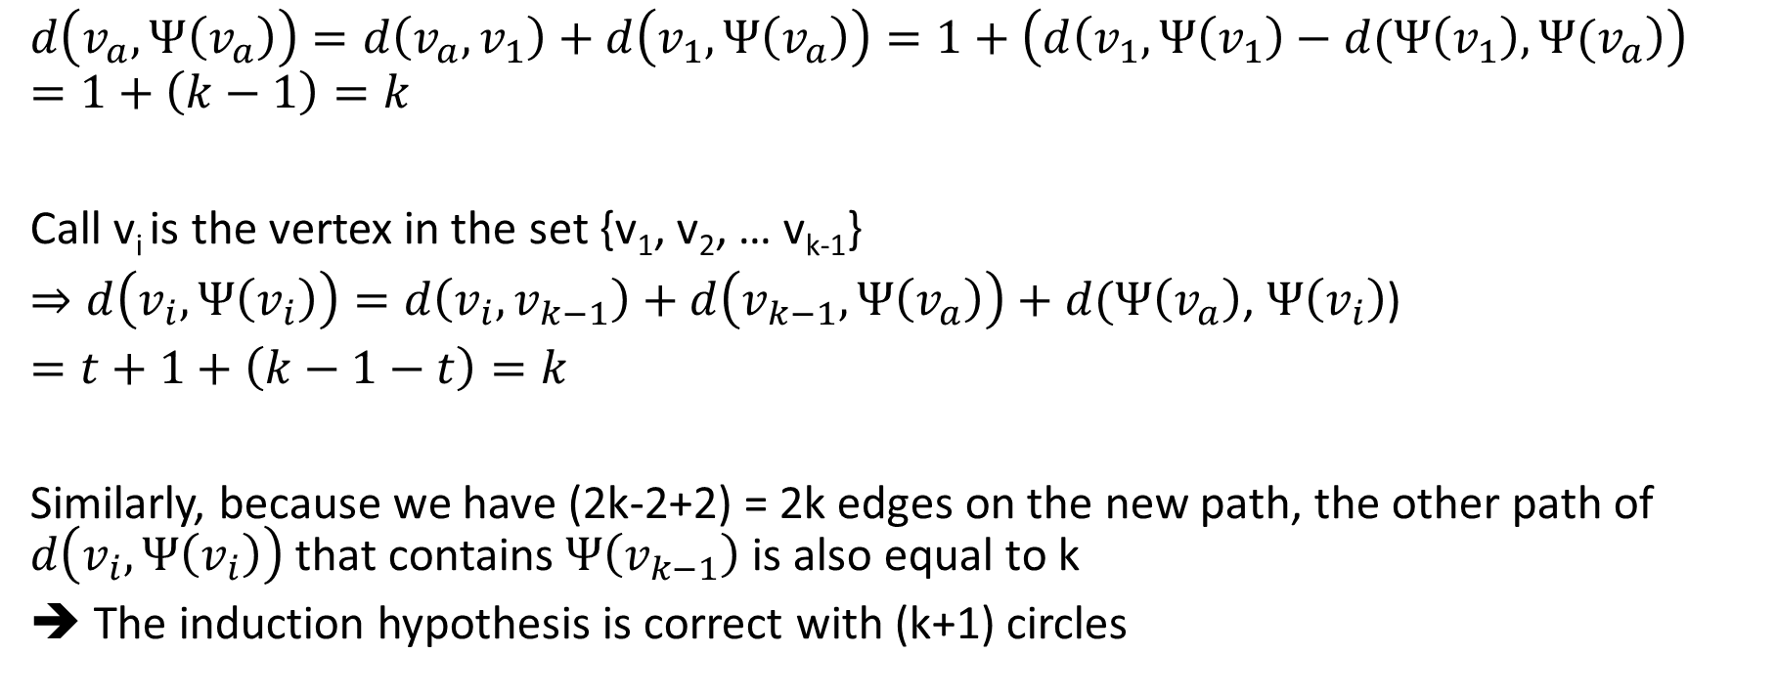
Lemma 1 - Proof
$$d\left(v_{a},Ψ\left(v_{a}\right)\right)=d\left(v_{a}, v_{1}\right)+d\left(v_{1},Ψ\left(v_{a}\right)\right)=1+\left(d\left(v_{1},Ψ\left(v_{1}\right)−d(Ψ\left(v_{1}\right),Ψ(v_{a}\right)\right)$$
$$=1+\left(k−1\right)=k$$
Call v_{i} is the vertex in the set {v₁, v₂, … v_{k-1}}
$⇒d\left(v_{i},Ψ\left(v_{i}\right)\right)=d\left(v_{i}, v_{k−1}\right)+d\left(v_{k−1},Ψ\left(v_{a}\right)\right)+d(Ψ\left(v_{a}\right)$, $Ψ\left(v_{i}\right)$)
$=t+1+\left(k−1−t\right)=k$
Similarly, because we have (2k-2+2) = 2k edges on the new path, the other path of $d\left(v_{i},Ψ\left(v_{i}\right)\right)$ that contains $Ψ\left(v_{k−1}\right)$ is also equal to k
➔ The induction hypothesis is correct with (k+1) circles

Slide 7
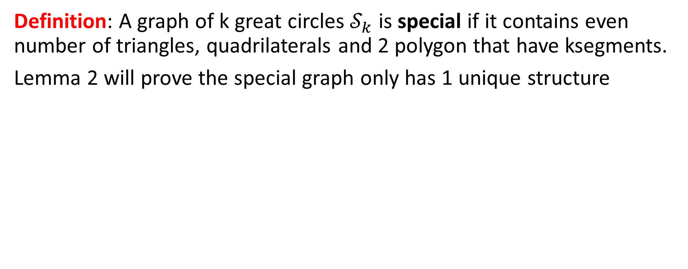
The special graph
Definition: A graph of k great circles $𝒮_{k}$ is special if it contains even number of triangles, quadrilaterals and 2 polygon that have ksegments.
Lemma 2 will prove the special graph only has 1 unique structure
6 great circles
7 great circles

Slide 8
Lemma 2. (The uniqueness of the special graph)
S_{k} is unique and it has the following form:
K triangles at the “outer cycle”
Another k triangles are made by the reflection and 1 polygon has k segments in the “middle”
The other polygons are quadrilaterals

Slide 9
Lemma 2 – Another drawing
Quadrilaterals …
Quadrilaterals …
Quadrilaterals …
The polygon and k triangles bounded
The polygon and k triangles bounded

Slide 10
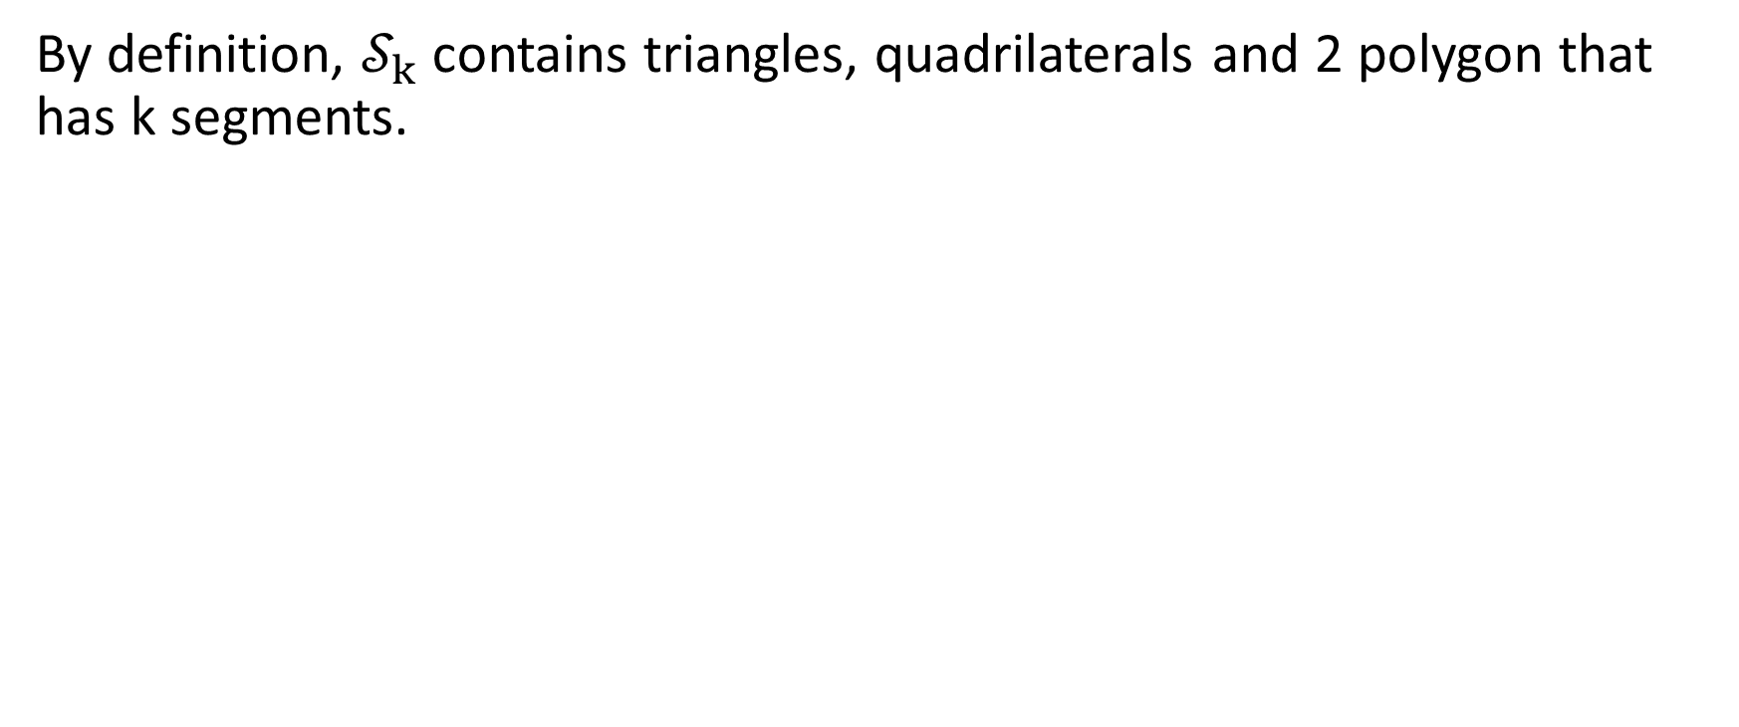
Lemma 2 – Proof
By definition, $𝒮_{k}$ contains triangles, quadrilaterals and 2 polygon that has k segments.

Slide 11
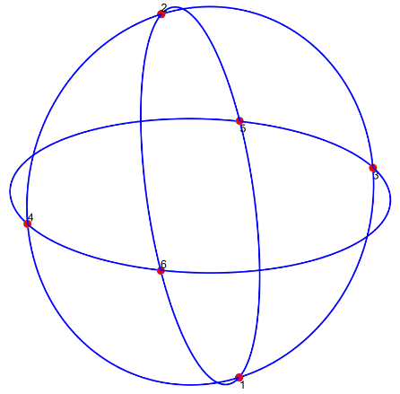
Lemma 2 – Proof
3 great circles has 1 non-isomorphic graph and it’s special (We can verify it easily by hand)
3 great circles

Slide 12
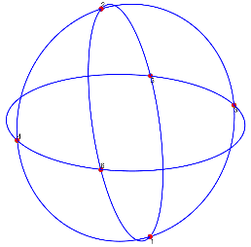
Lemma 2 – Proof
+ 1 great circle = ???
There are 3 cases happen when the 4th great circle is added:
It cuts arc(1,5), arc(1,3), arc(2,6), arc(2,4), arc(3,6) and arc(4,5)
It cuts arc(1,3), arc(3,5), arc(2,4), arc(4,6), arc(1,6) and arc(2,5)
It cuts arc(1,5), arc(3,5), arc(2,6), arc(4,6), arc(2,6) and arc(1,5)
The outcome of 3 cases is the same as the figure on the right. This graph is special and unique
4 great circles

Slide 13
Lemma 2 – Proof
3 and 4 great circles only have 1 non-isomorphic graph
They are both S₃ and S₄ respectively
➔ We can assume S_{k} is somehow similar to S₃ and S₄
3 great circles
4 great circles
k great circles

Slide 14
Lemma 2 – Proof
We may have a form of S_{k}
If we may have different ways to create non-isomorphic graphs for S_{k}, it’s also true in case of S_{k+1}
In case of S₄ was created by S₃ , we can do believe that S_{k+1} may be derived from S_{k}
This form of S_{k} is capable of generating all non-isomorphic graphs of S_{k+1}
k great circles

Slide 15
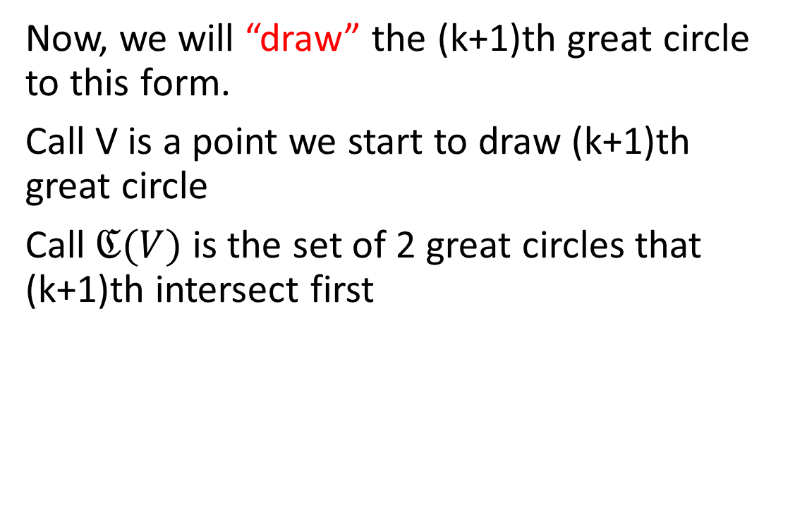
Lemma 2 – Proof
Now, we will “draw” the (k+1)th great circle to this form.
Call V is a point we start to draw (k+1)th great circle
Call $ℭ(V)$ is the set of 2 great circles that (k+1)th intersect first
k great circles

Slide 16
Lemma 2 – Proof
The rule to make S_{k+1}:
Don’t make any quadrilaterals into pentagonals
A circle will intersect C_{k+1} at 2 intersections
2*k intersections are added into the current graph after C_{k+1} is implemented
k great circles

Slide 17
Lemma 2 – Proof
We have 2 cases for the drawing:
V is located at the outer face. It means (k+1)th will change the outer cycle that’s supposed to be bounded by triangles
V is located at a face inside of the graph and (k+1)th will not include any part of outer face
k great circles

Slide 18
Lemma 2 – Proof – Case 1
An example of incorrect drawing

Slide 19
Lemma 2 – Proof
Some definitions before going into details of the proof
A special path is the path from a triangle at the outer cycle to the middle polygon such that it doesn’t make any
There are 2 special paths starting at a triangle at the outer cycle
The special path will intersect at (k-1) points to be in the middle polygon (By lemma 1.1)
k great circles

Slide 20
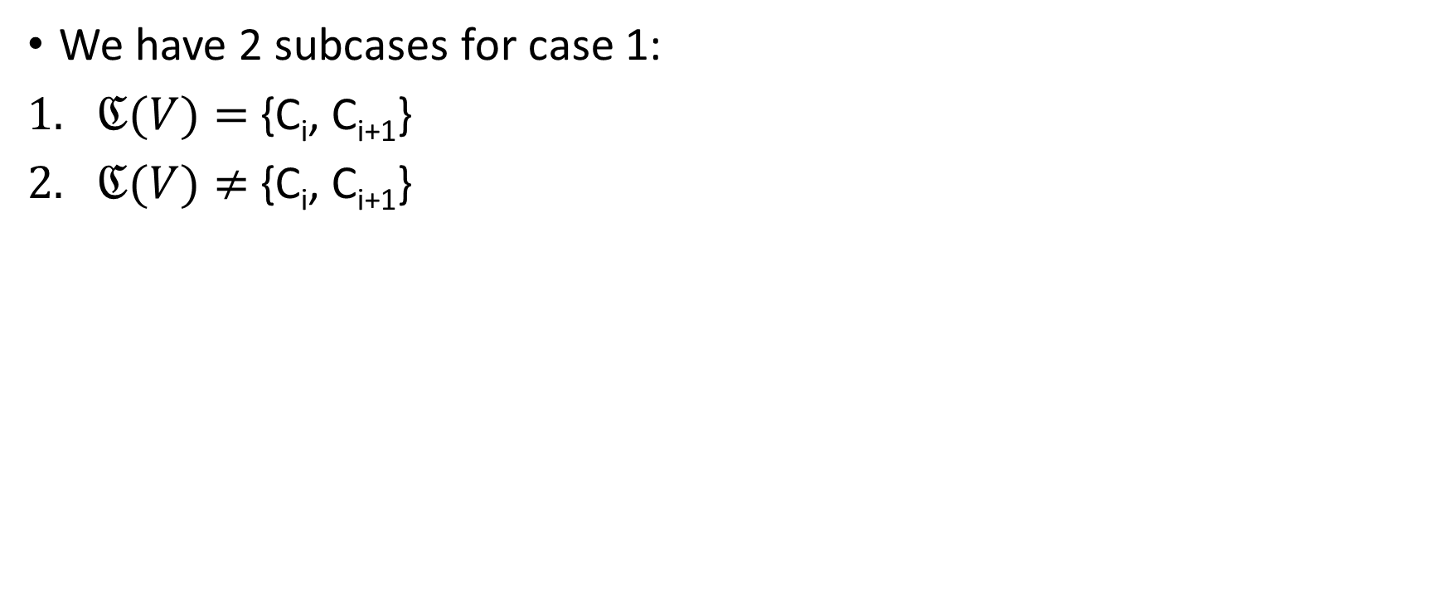
Lemma 2 – Proof – Case 1
We have 2 subcases for case 1:
$ℭ(V)=$ {C_{i}, C_{i+1}}
$ℭ(V)≠$ {C_{i}, C_{i+1}}
k great circles

Slide 21
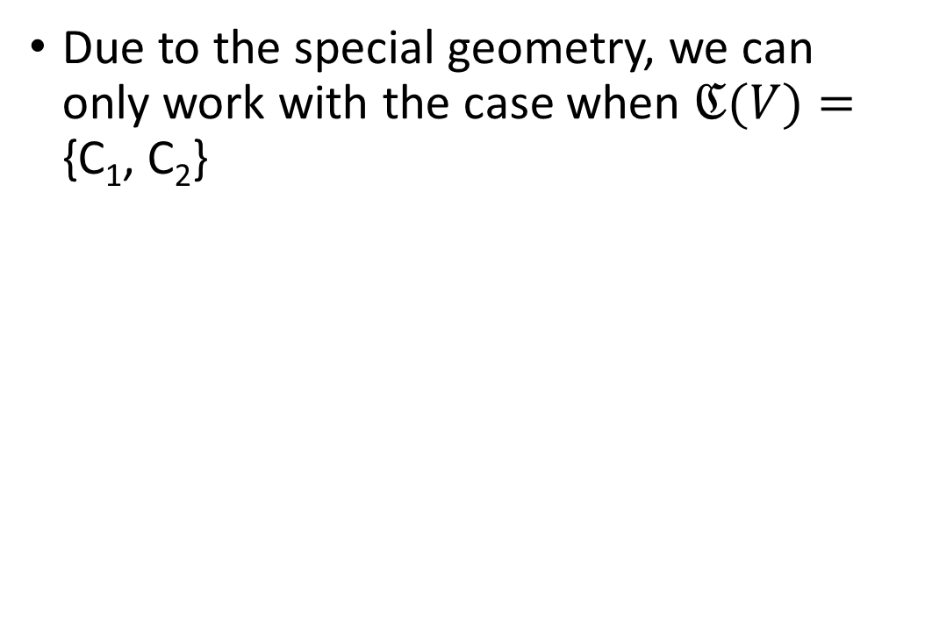
Lemma 2 – Proof – Case 1.1
Due to the special geometry, we can only work with the case when $ℭ(V)=$ {C₁, C₂}
k great circles

Slide 22
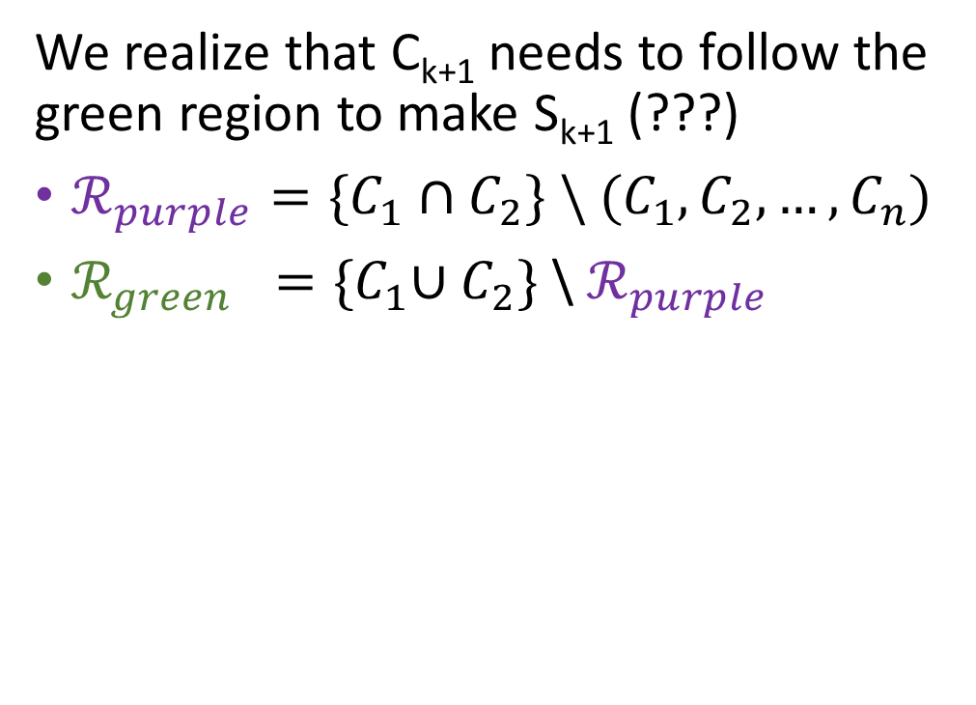
Lemma 2 – Proof – Case 1.1
We realize that C_{k+1} needs to follow the green region to make S_{k+1} (???)
$ℛ_{purple}=\{C_{1}∩C_{2}\} \backslash (C_{1},C_{2},…,C_{n})$
$ℛ_{green} ={\{C}_{1}∪C_{2}\}$ \ $ℛ_{purple}$

Slide 23
Lemma 2 – Proof – Case 1.1
FAILED!!!

Slide 24
Lemma 2 – Proof – Case 1.1
Finally, this form is the only one for S_{k+1} we can get in case 1.1
C_{k+1} created 2k intersections
Every special path created (k-1)
C_{k+1} created: 2*(k-1) + 2 at the outer cycle = 2k
Lemma 1.2 is still true in the new S_{k+1}

Slide 25
Lemma 2 – Proof – Case 1.1
The outcome has exactly the same form for (k+1) circles we assume
Redraw

Slide 26
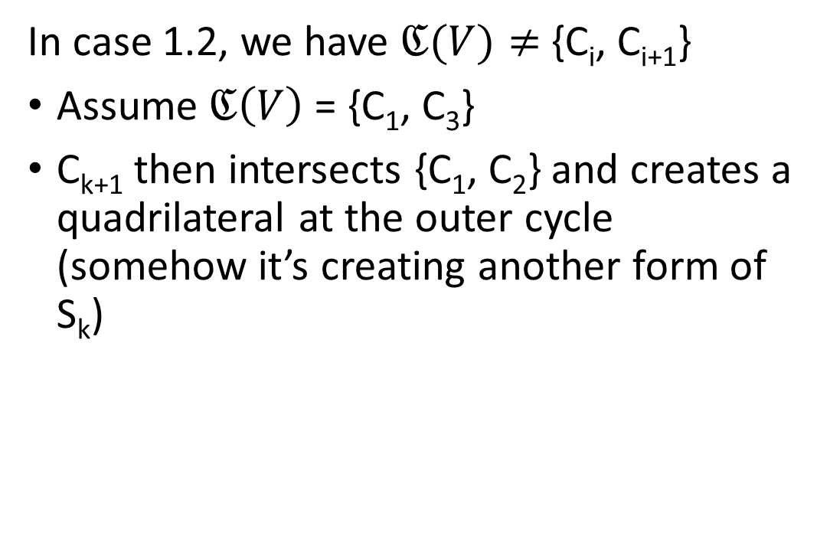
Lemma 2 – Proof – Case 1.2
In case 1.2, we have $ℭ(V)≠$ {C_{i}, C_{i+1}}
Assume $ℭ\left(V\right)$ = {C₁, C₃}
C_{k+1} then intersects {C₁, C₂} and creates a quadrilateral at the outer cycle (somehow it’s creating another form of S_{k})

Slide 27
Lemma 2 – Proof – Case 1.2
FAILED!!!
Notes:
There are 4 possibilities

Slide 28
Lemma 2 – Proof – Case 1.2
FAILED!!!
They both meet at the triangle (C₁, C₂, C₃) in the middle and only have (2k-2) points

Slide 29
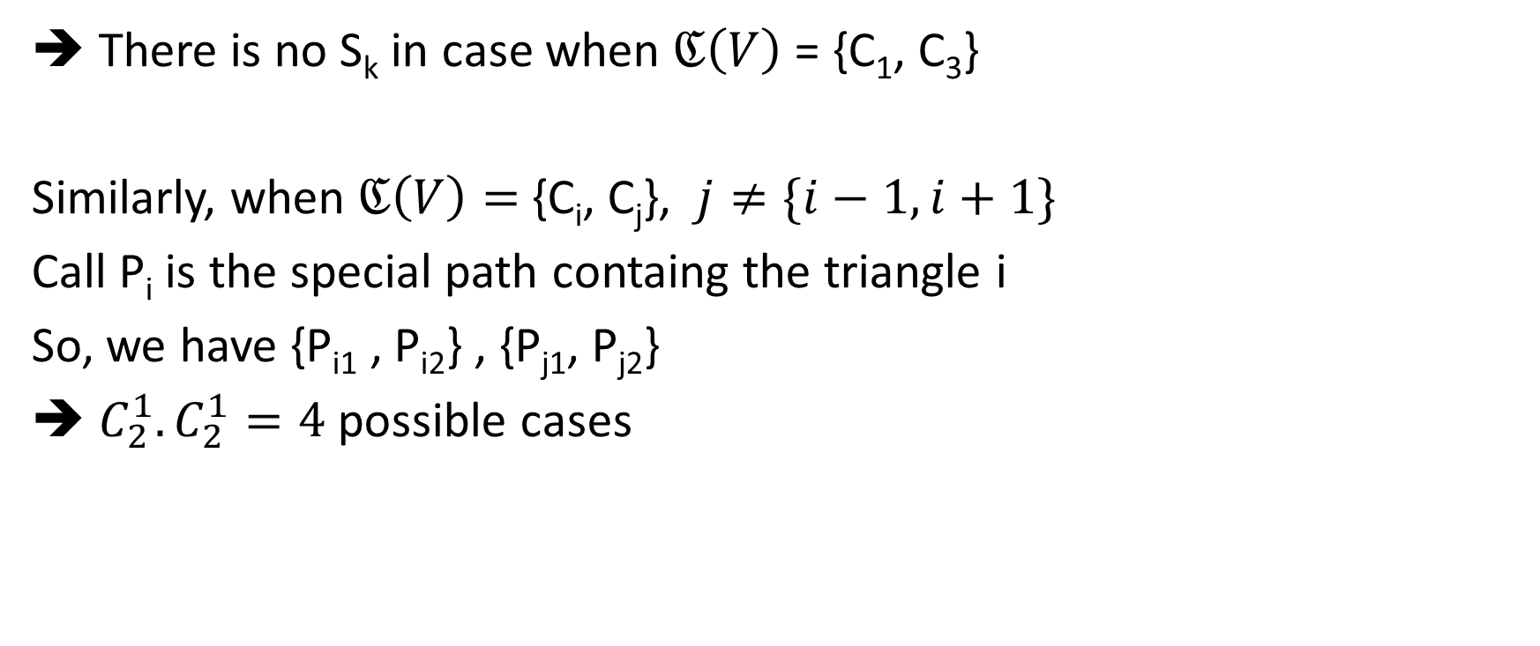
Lemma 2 – Proof – Case 1.2
➔ There is no S_{k} in case when $ℭ\left(V\right)$ = {C₁, C₃}
Similarly, when $ℭ\left(V\right)=$ {C_{i}, C_{j}}, $j≠\{i−1,i+1\}$
Call P_{i} is the special path containg the triangle i
So, we have {P_{i1} , P_{i2}} , {P_{j1}, P_{j2}}
➔ $C_{2}^{1}.C_{2}^{1}=4$ possible cases

Slide 30
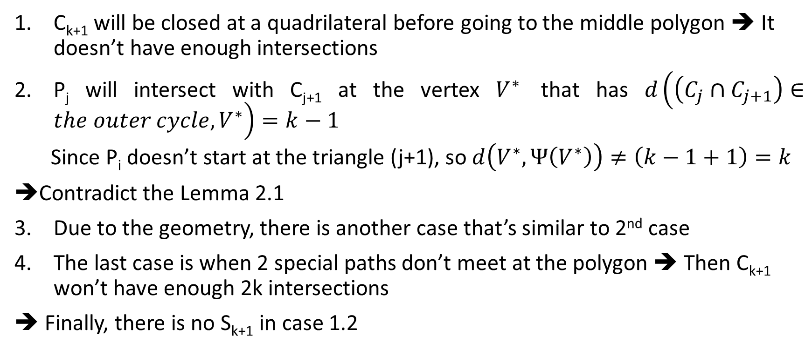
Lemma 2 – Proof – Case 1.2
C_{k+1} will be closed at a quadrilateral before going to the middle polygon ➔ It doesn’t have enough intersections
P_{j} will intersect with C_{j+1} at the vertex $V^{∗}$ that has $d\left(\left(C_{j}∩C_{j+1}\right)∈the outer cycle, V^{∗}\right)=k−1$
Since P_{i} doesn’t start at the triangle (j+1), so $d\left(V^{∗},Ψ\left(V^{∗}\right)\right)≠\left(k−1+1\right)=k$
Contradict the Lemma 2.1
Due to the geometry, there is another case that’s similar to 2nd case
The last case is when 2 special paths don’t meet at the polygon ➔ Then C_{k+1} won’t have enough 2k intersections
➔ Finally, there is no S_{k+1} in case 1.2

Slide 31
Lemma 2 – Proof – Case 2
In case 2, the (k+1)^{th} circle will only travel inside of the current form of S_{k} .
We will prove there is no such S_{k+1} made in this case.
An example of drawing in this case but it isn’t satisfied

Slide 32
Lemma 2 – Proof – Case 2
Starting at the center of the graph, we have paths tend to the triangles at the outer cycle. So WLOG, set V is in any triangle at the outer cycle.
There are 2 cases happen
The starting point and ending point are in the different triangle.
The starting point and ending point are in the same triangle.
An example of drawing in Case 2.1

Slide 33
Lemma 2 – Proof – Case 2
Case 2.1: The starting point and ending point are in the different triangle.
C_{k+1} must start at a triangle at the outer cycle, go to center then return back to another triangle at the outer cycle
There is only path as defined
The path connecting 2 triangles must create a pentagonal !!!
➔ There is no S_{k+1} in Case 2.1
An example of drawing in Case 2.1

Slide 34
Lemma 2 – Proof – Case 2
Case 2.2: The starting point and ending point are in the same triangle.
C_{k+1}doesn’t intersect C₂ !!!
➔ There is no S_{k+1} in Case 2.2

Slide 35
Lemma 2 – Proof
So there is only the case 1.1 creates a S_{k+1}
We only found a graph for S_{k+1} that is exactly depicted by the induction hypothesis for S_{k+1}
S_{k+1} is unique

Slide 36
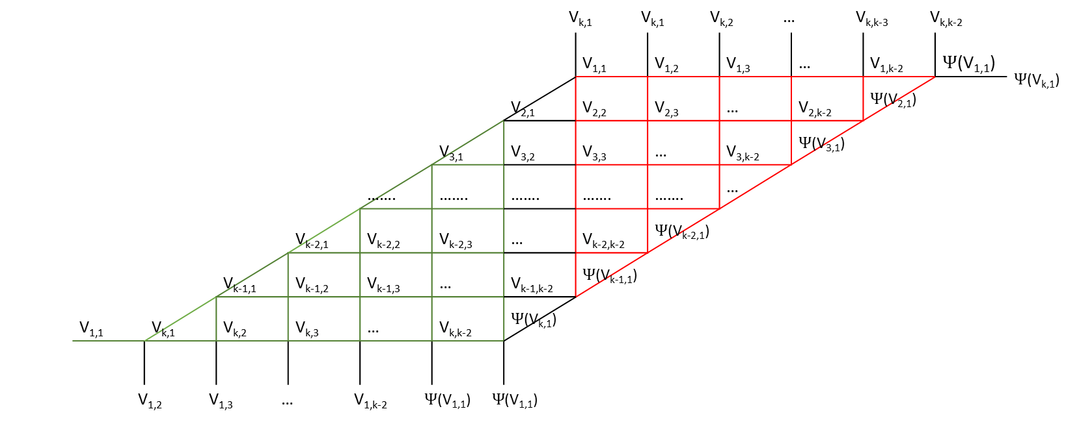
Lemma 3.
S_{k} can be transform into the following equivalent graph:
V_{k,1} V_{k,1} V_{k,2} … V_{k,k-3} V_{k,k-2} |  |  |  |  |  |  |  |  |  |  |  |  |  | $Ψ$(V_{k,1})
 |  |  |  |  |  |  |  | V_{1,1} | V_{1,2} | V_{1,3} | … | V_{1,k-2} | $Ψ$(V_{1,1})
 |  |  |  |  |  |  | V_{2,1} | V_{2,2} | V_{2,3} | … | V_{2,k-2} | $Ψ$(V_{2,1})
 |  |  |  |  |  | V_{3,1} | V_{3,2} | V_{3,3} | … | V_{3,k-2} | $Ψ$(V_{3,1})
 |  |  |  |  | ……. | ……. | ……. | ……. | ……. | …
 |  |  |  | V_{k-2,1} | V_{k-2,2} | V_{k-2,3} | … | V_{k-2,k-2} | $Ψ$(V_{k-2,1})
 |  |  | V_{k-1,1} | V_{k-1,2} | V_{k-1,3} | … | V_{k-1,k-2} | $Ψ$(V_{k-1,1})
 | V_{1,1} | V_{k,1} | V_{k,2} | V_{k,3} | … | V_{k,k-2} | $Ψ$(V_{k,1})
V_{1,2} V_{1,3} … V_{1,k-2} $Ψ$(V_{1,1}) $Ψ$(V_{1,1})

Slide 37
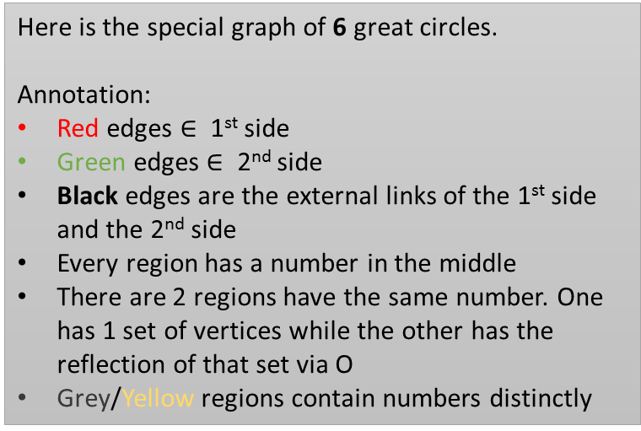
Lemma 3 – Proof – A base case with 6 circles
Here is the special graph of 6 great circles.
Annotation:
Red edges $∈$ 1st side
Green edges $∈$ 2nd side
Black edges are the external links of the 1st side and the 2nd side
Every region has a number in the middle
There are 2 regions have the same number. One has 1 set of vertices while the other has the reflection of that set via O
Grey/Yellow regions contain numbers distinctly

Slide 38
Lemma 3 – Proof – A base case with 6 circles
17 17 16 2 12 |  |  |  |  |  | 14
19 | 13 | 27 | 25 | 6 | 20
19 | 11 | 23 | 21 | 4
5 | 1 | 9 | 7
26 | 15 | 29
28 | 18
 | 14
18 18 15 1 11 |  |  |  |  |  | 13
20 | 14 | 28 | 26 | 5 | 19
20 | 12 | 24 | 22 | 3
6 | 2 | 10 | 8
25 | 16 | 30
27 | 17
 | 13
The number in this grid are vertices

Slide 39
Lemma 3 – Proof – A base case with 6 circles
 | 17 17 16 2 12 |  |  |  |  |  |  |  |  |  | 14
 |  |  |  |  |  | 13 | 27 | 25 | 6 | 20
 |  |  |  |  | 19 | 11 | 23 | 21 | 4
 |  |  |  | 3 | 5 | 1 | 9 | 7
 |  |  | 8 | 22 | 26 | 15 | 29
 |  | 30 | 10 | 24 | 28 | 18
13 | 17 | 16 | 2 | 12 | 14
 | 27 | 25 | 6 | 20 | 20
17 17 16 2 12 |  |  |  |  |  | 14
19 | 13 | 27 | 25 | 6 | 20
19 | 11 | 23 | 21 | 4
5 | 1 | 9 | 7
26 | 15 | 29
28 | 18
 | 14
18 18 15 1 11 |  |  |  |  |  | 13
20 | 14 | 28 | 26 | 5 | 19
20 | 12 | 24 | 22 | 3
6 | 2 | 10 | 8
25 | 16 | 30
27 | 17
 | 13
The number in this grid are vertices

Slide 40

Lemma 3 – Proof – A base case with 7 circles
Here is the special graph of 7 great circles.
Annotation:
Red edges $∈$ 1st side
Green edges $∈$ 2nd side
Black edges are the external links of the 1st side and the 2nd side
Every region has a number in the middle
There are 2 regions have the same number. One has 1 set of vertices while the other has the reflection of that set via O
Grey/Yellow regions contain numbers distinctly

Slide 41
Lemma 3 – Proof – A base case with 7 circles
24 24 25 27 13 3 |  |  |  |  |  |  | 29
12 | 30 | 36 | 40 | 42 | 21 | 11
12 | 4 | 6 | 8 | 10 | 2
22 | 14 | 16 | 18 | 20
41 | 28 | 34 | 38
39 | 26 | 32
35 | 23
 | 29
23 23 26 28 14 4 |  |  |  |  |  |  | 30
11 | 29 | 35 | 39 | 41 | 22 | 12
11 | 3 | 5 | 7 | 9 | 1
21 | 13 | 15 | 17 | 19
42 | 27 | 33 | 37
40 | 25 | 31
36 | 24
 | 30
The number in this grid are vertices

Slide 42
Lemma 3 – Proof – A base case with 7 circles
24 24 25 27 13 3 |  |  |  |  |  |  | 29
12 | 30 | 36 | 40 | 42 | 21 | 11
12 | 4 | 6 | 8 | 10 | 2
22 | 14 | 16 | 18 | 20
41 | 28 | 34 | 38
39 | 26 | 32
35 | 23
 | 29
24 24 25 27 13 3 |  |  |  |  |  |  |  |  |  |  |  |  |  | 29
 |  |  |  |  |  |  |  | 30 | 36 | 40 | 42 | 21 | 11
 |  |  |  |  |  |  | 12 | 4 | 6 | 8 | 10 | 2
 |  |  |  |  |  | 1 | 22 | 14 | 16 | 18 | 20
 |  |  |  |  | 19 | 9 | 41 | 28 | 34 | 38
 |  |  |  | 37 | 17 | 7 | 39 | 26 | 32
 |  |  | 31 | 33 | 15 | 5 | 35 | 23
 | 30 | 24 | 25 | 27 | 13 | 3 | 29
36 40 42 21 11 11
23 23 26 28 14 4 |  |  |  |  |  |  | 30
11 | 29 | 35 | 39 | 41 | 22 | 12
11 | 3 | 5 | 7 | 9 | 1
21 | 13 | 15 | 17 | 19
42 | 27 | 33 | 37
40 | 25 | 31
36 | 24
 | 30
The number in this grid are vertices

Slide 43
Lemma 3
Call
V_{i,1} are the vertices made by C_{i} and C_{i+1} on the unbounded cycle.
V_{i,1} , V_{i,2} , V_{i,3} , … V_{i,2k-2} are the vertices on the circle C_{i} in the order that (V_{i,1}, V_{i,2}, V_{i+1,1} ) is a triangle

Slide 44
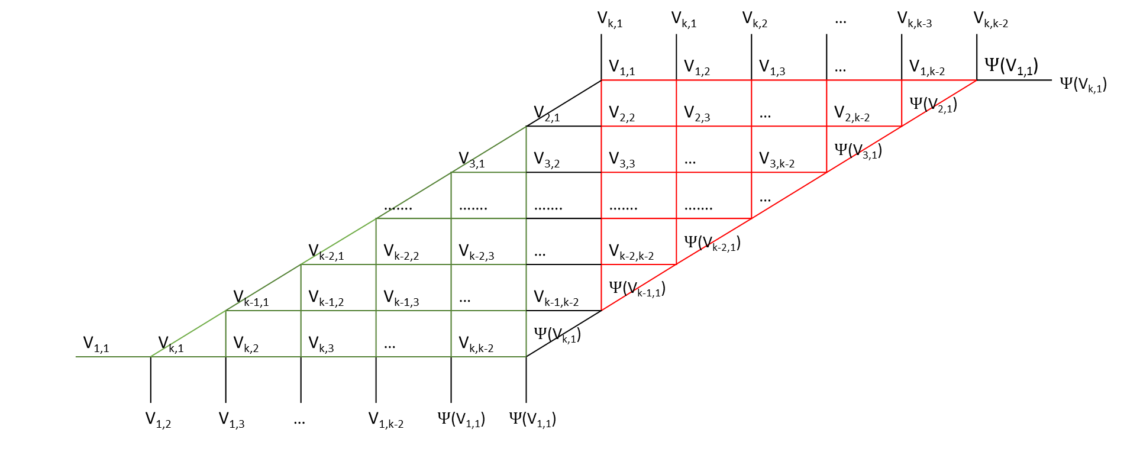
k-1 vertices
V_{k,1} V_{k,1} V_{k,2} … V_{k,k-3} V_{k,k-2} |  |  |  |  |  |  |  |  |  |  |  |  |  | $Ψ$(V_{k,1})
 |  |  |  |  |  |  |  | V_{1,1} | V_{1,2} | V_{1,3} | … | V_{1,k-2} | $Ψ$(V_{1,1})
 |  |  |  |  |  |  | V_{2,1} | V_{2,2} | V_{2,3} | … | V_{2,k-2} | $Ψ$(V_{2,1})
 |  |  |  |  |  | V_{3,1} | V_{3,2} | V_{3,3} | … | V_{3,k-2} | $Ψ$(V_{3,1})
 |  |  |  |  | ……. | ……. | ……. | ……. | ……. | …
 |  |  |  | V_{k-2,1} | V_{k-2,2} | V_{k-2,3} | … | V_{k-2,k-2} | $Ψ$(V_{k-2,1})
 |  |  | V_{k-1,1} | V_{k-1,2} | V_{k-1,3} | … | V_{k-1,k-2} | $Ψ$(V_{k-1,1})
 | V_{1,1} | V_{k,1} | V_{k,2} | V_{k,3} | … | V_{k,k-2} | $Ψ$(V_{k,1})
V_{1,2} V_{1,3} … V_{1,k-2} $Ψ$(V_{1,1}) $Ψ$(V_{1,1})
k rows

Slide 45
Lemma 4. The properties of S_{k}
There are 2k triangles, (k+1)*(k-3) quadrilaterals and 2 polygon has k segments.
Proof: By Lemma 2 and Lemma 3, we can easily count this

Slide 46
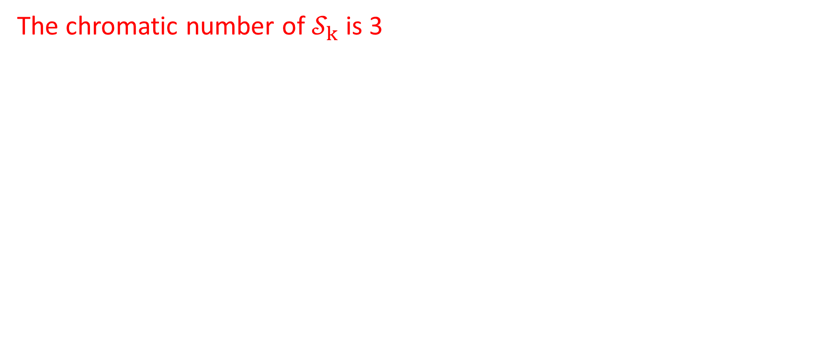
Theorem 1
The chromatic number of $𝒮_{k}$ is 3

Slide 47
Theorem 1 – Proof
By Lemma 2.2, S_{k} is unique
By Lemma 3, S_{k} can be transformed into an equivalent parallelogram
The proof to prove the equivalent parallelogram is 3-colorable is in the presentation in 01-25-2015

Slide 48
Adding a circle

Slide 49
Adding a circle
This part presents how a graph is changed after adding a random great circle into it
I will show the transitions from graphs of 5, 6 great circles to 6, 7 great circles respectively

Slide 50
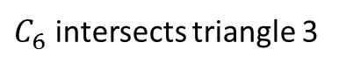
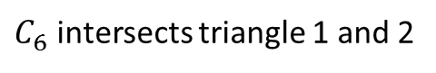
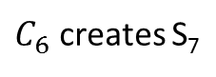
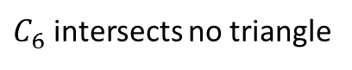
5->6 great circles
$C_{6}$ intersects triangle 1 and 2
$C_{6}$ intersects triangle 3
S₅
$C_{6}$ intersects no triangle
$C_{6}$ creates S₇

Slide 51
6->7 great circles - 1
S₆
S₆ ; a circle intersecting triangle 1

Slide 52
6->7 great circles - 2
S₆
S₆ ; a circle intersecting triangle 5 and 6

Slide 53
6->7 great circles - 3
S₅ ; a circle intersecting triangle 3
S₅ ; 2 circles intersecting triangle 3 and they also intersected each other in the triangle 3

Slide 54
6->7 great circles - 4
S₅ ; a circle intersecting triangle 1 and 2
; a circle intersecting triangle 1 and 5
S₅ ; a circle intersecting triangle 1 and 2

Slide 55
6->7 great circles - 5
S₅ ; a circle intersecting triangle 3
; a circle intersecting 2 and 2
; 2 circles intersected inside of triangle 3
S₅ ; a circle intersecting triangle 3

Slide 56
6->7 great circles - 6
S₆
S₆ ; a circles doesn’t intersect any triangle

Slide 57
6->7 great circles - 7
S₅ ; a circle intersecting triangle 1 and 2
S₅ ; a circle intersecting triangle 1 and 2
; a cicle doesn’t intersect any triangle

Slide 58
6->7 great circles - 8
S₅ ; a circle intersecting triangle 1 and 2
S₅ ; 2 circles intersecting triangle 1 and 2

Slide 59
6->7 great circles - 9
S₅ ; a circle intersecting triangle 1 and 2
S₅ ; 2 circles intersecting triangle 1 and 2 and they also intersected each other in the triangle 1

Slide 60
6->7 great circles - 10
S₆; a circle doesn’t intersect any triangle
S₆
S₆; a circle doesn’t intersect any triangle
S₅ ; a circle doesn’t intersect any triangle

Slide 61
6->7 great circles - 11
S₆
S₇

